Slide 1
Semaphore

Slide 2
Semaphore
It is intoduce by DiJisktra in 1956
Semaphore is signalling mechanism. It allow a no. of threads to access sheared resources.
Semaphore is an integer variable which is used in mutual exclusive manner by various concurrent cooperative processes in order to acheived process syncronization
Semaphore
Binary
(0, 1)
Counting
(-infinity to +infinity)

Slide 3
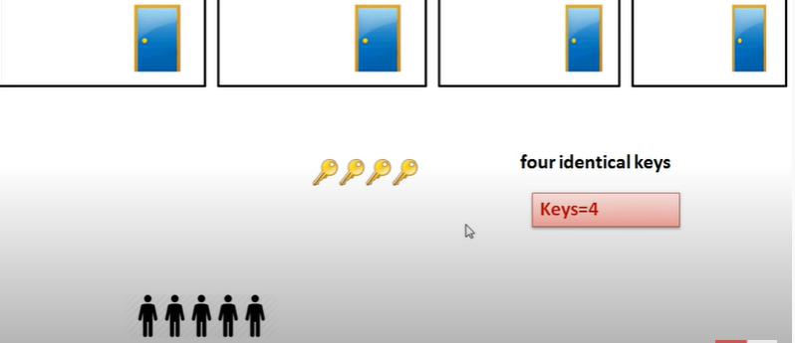
Semaphore

Slide 4
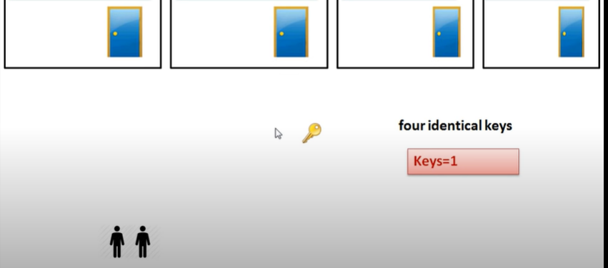

Slide 5
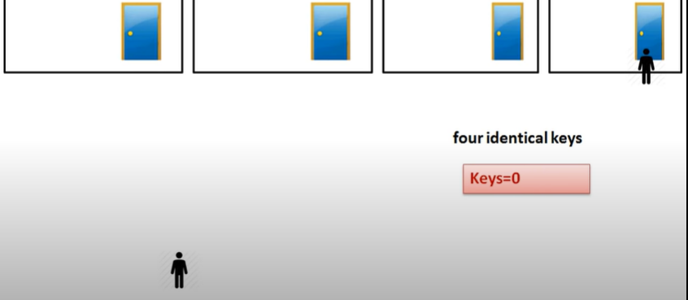

Slide 6
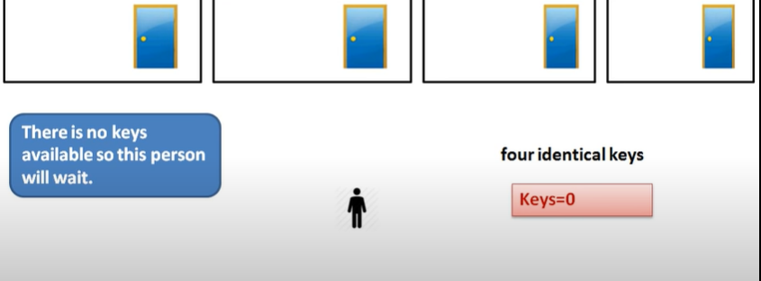

Slide 7
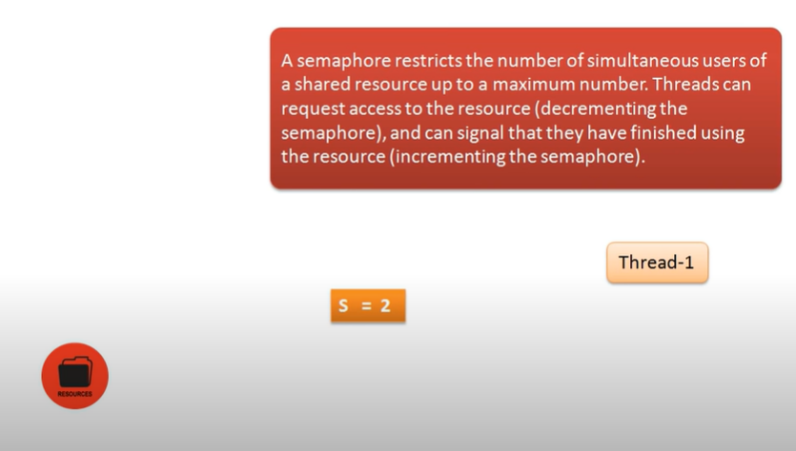

Slide 8
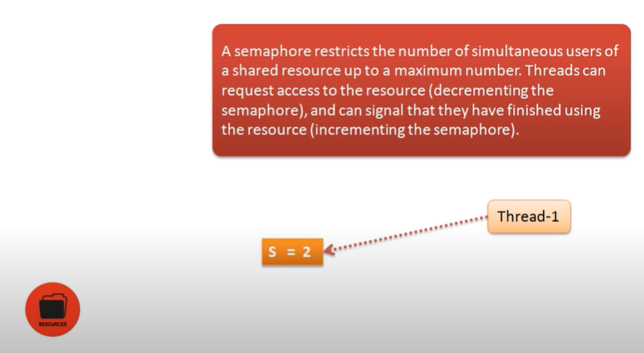

Slide 9
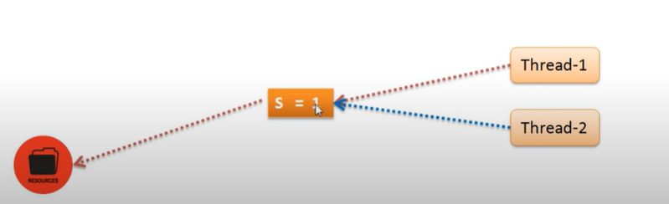

Slide 10
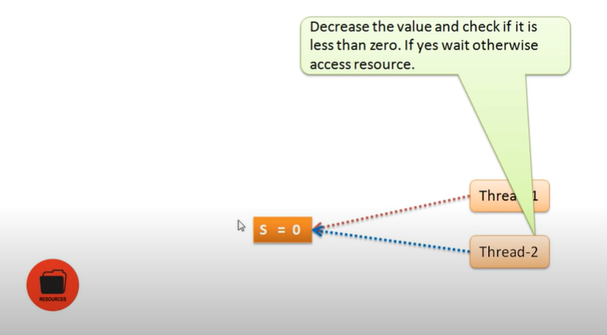

Slide 11
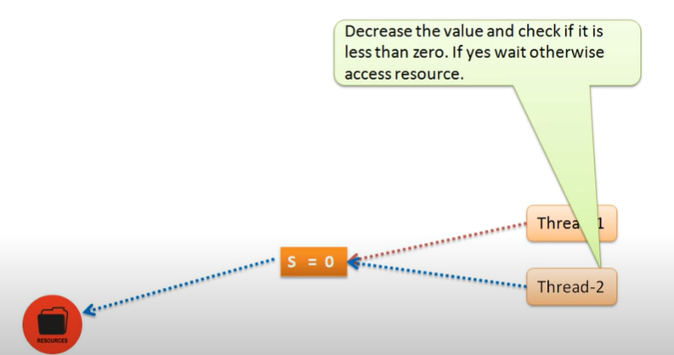

Slide 12
Binary Semaphore (0,1)
Two operations
P(S) Down, Sleep, Wait
V(S) Up, Wake-up, Signal
P(semaphore s)
{
while(s==0);
s=s-1;
}
V(semaphore s)
{
s=s+1;
}

Slide 13
Down(semaphore s)
{
s=s-1;
if(s<0)
{
put process PCB in suspended list Sleep()
}
else
return
}
V(semaphore s)
{
s=s+1;
if(s<=0)
{
select process from suspended list Wake up()
}
}
Entry section code
Exit section code

Slide 14
Binary Semaphore
Down(semaphore s)
{
s=s-1;
if(s<0)
{
put process PCB in suspended list Sleep()
}
else
return
}
P1 come and want to access CS , it come after running its entry code
from where s decrease 1 and beome 0
P1
Critical Section(CS)
S=1 0

Slide 15
P1 come and want to access CS , it come after running its entry code
from where s decrease 1 and beome 0
Critical Section(CS)
P1
S=1 0

Slide 16
Down(semaphore s)
{
s=s-1;
if(s<0)
{
put process PCB in suspended list Sleep()
}
else
return
}
P2
P2 come and want to access CS , it come after running its entry code
from where s =0. Whenever s remain 0 nobody can enter in CS. They have to wait
Critical Section(CS)
P1
S=1 0

Slide 17
V(semaphore s)
{
s=s+1;
if(s<=0)
{
select process from suspended list Wake up()
}
}
Whenever P1 terminate its execution from CS it execute its exit code, So s=1. This time P2 can get access of CS.
Critical Section(CS)
P1
S=1 0

Slide 18
P2
P2 check and want to access CS , it come after running its entry code
from where s =1 which means P2 can get access
Critical Section(CS)
P1
S=1 0

Slide 19
Down(semaphore s)
{
s=s-1;
if(s<0)
{
put process PCB in suspended list Sleep()
}
else
return
}
P2 check and want to access CS , it come after running its entry code
from where s =0 which means P2 can get access
Critical Section(CS)
P2
P1
S=1 0

Slide 20
V(semaphore s)
{
s=s+1;
if(s<=0)
{
select process from suspended list Wake up()
}
}
Whenever P2 terminate its execution from CS it execute its exit code, So s=1 again which mean CS is blank for taking other process.
Critical Section(CS)
P2
S=1 0
So Mutual Exclusive condition is satisfied here.

Slide 21
Counting Semaphore
P1
Entry section code
Critical Section(CS)
P1 come
pass with entry code
it decrese s vale by 1
and enter into CS
P(S)
s--;
check s<0
V(S)
Exit section code
S=5

Slide 22
Counting Semaphore
P1
Entry section code
Critical Section(CS)
P1 come
pass with entry code
it decrese s vale by 1
and enter into CS
P(S)
s--;
check s<0
V(S)
P1
Exit section code
S=5
4

Slide 23
Counting Semaphore
P2
Entry section code
Critical Section(CS)
P2 come
pass with entry code
it decrese s vale by 1
and enter into CS
P(S)
s--;
check s<0
V(S)
P1
Exit section code
S=5
4

Slide 24
Counting Semaphore
Entry section code
Critical Section(CS)
P2 come
pass with entry code
it decrese s vale by 1
and enter into CS
P(S)
s--;
check s<0
V(S)
P1
P2
Exit section code
S=5
4
3

Slide 25
Counting Semaphore
P3
Entry section code
Critical Section(CS)
P3 come
pass with entry code
it decrese s vale by 1
and enter into CS
P(S)
s--;
check s<0
V(S)
P1
P2
Exit section code
S=5
4
3

Slide 26
Counting Semaphore
Entry section code
Critical Section(CS)
P3 come
pass with entry code
it decrese s vale by 1
and enter into CS
P(S)
s--;
check s<0
V(S)
P1
P2
P3
Exit section code
S=5
4
3
2

Slide 27
Counting Semaphore
P4
Entry section code
Critical Section(CS)
P4 come
pass with entry code
it decrese s vale by 1
and enter into CS
P(S)
s--;
check s<0
V(S)
P1
P2
P3
Exit section code
S=5
4
3
2

Slide 28
Counting Semaphore
Entry section code
Critical Section(CS)
P4 come
pass with entry code
it decrese s vale by 1
and enter into CS
P4
P(S)
s--;
check s<0
V(S)
P1
P2
P3
Exit section code
S=5
4
3
2
1

Slide 29
Counting Semaphore
P5
Entry section code
Critical Section(CS)
P5 come
pass with entry code
it decrese s vale by 1
and enter into CS
P4
P(S)
s--;
check s<0
V(S)
P1
P2
P3
Exit section code
S=5
4
3
2
1

Slide 30
Counting Semaphore
Entry section code
Critical Section(CS)
P5 come
pass with entry code
it decrese s vale by 1
and enter into CS
P4
P(S)
s--;
check s<0
V(S)
P1
P2
P3
P5
Exit section code
S=5
4
3
2
1
0

Slide 31
Counting Semaphore
P6
Entry section code
Critical Section(CS)
P6 come
pass with entry code
it decrese s vale by 1
and enter into CS
P4
P(S)
s--;
check s<0
V(S)
P1
P2
P3
P6
Exit section code
S=5
4
3
2
1
0

Slide 32
Counting Semaphore
P6
Suspended List
P6
Entry section code
Critical Section(CS)
P6 come
pass with entry code
it decrese s vale by 1
and try to enter into CS
P4
P(S)
s--;
check s<0
V(S)
P1
P2
P3
P5
Exit section code
Whenever s=-1 that process who is responsible for this. that process send to suspended list
S=5
4
3
2
1
0
-1

Slide 33
Counting Semaphore
P7
Suspended List
P6
P7
Entry section code
Critical Section(CS)
P7 come
pass with entry code
it decrese s vale by 1
and try to enter into CS
P4
P(S)
s--;
check s<0
V(S)
P1
P2
P3
P5
Exit section code
Whenever s=-1 that process who is responsible for this. that process send to suspended list
S=5
here negative value indicate how many process in suspended list
4
3
2
1
0
-1
-2

Slide 34
Counting Semaphore
Suspended List
P6
P7
Reverse process Start
Entry section code
Critical Section(CS)
P1 complete its execution
it pass with exit code
it increse s vale by 1
and trelease CS
P4
P(S)
check s<0
V(S)
s++;
P1
P2
P3
P5
Exit section code
S=5
4
3
2
1
0
-1
-2

Slide 35
Counting Semaphore
P6
Suspended List
P7
Reverse process Start
Entry section code
Critical Section(CS)
P1 complete its execution
it pass with exit code
it increse s vale by 1
and release CS
P4
P(S)
V(S)
s++;
check s<=0
P2
P3
P5
Exit section code
P1
S=5
At the same time semaphore look suspended list and kick out one process into ready que to give it a chance to get access CS again
4
3
2
1
0
-1
-2

Slide 36
Counting Semaphore
P6
P7
Suspended List
Reverse process Start
Entry section code
Critical Section(CS)
P2 complete its execution
it pass with exit code
it increse s vale by 1
and release CS
P4
P(S)
V(S)
s++;
check s<=0
P3
P5
Exit section code
P2
P1
S=5
At the same time semaphore look suspended list and kick out one process into ready que to give it a chance to get access CS again
here zero value indicate no process is in suspended list
4
3
2
1
0
-1
-2

